Slide 1

VARIOUS FRONT END APPLICATIONS

Slide 2
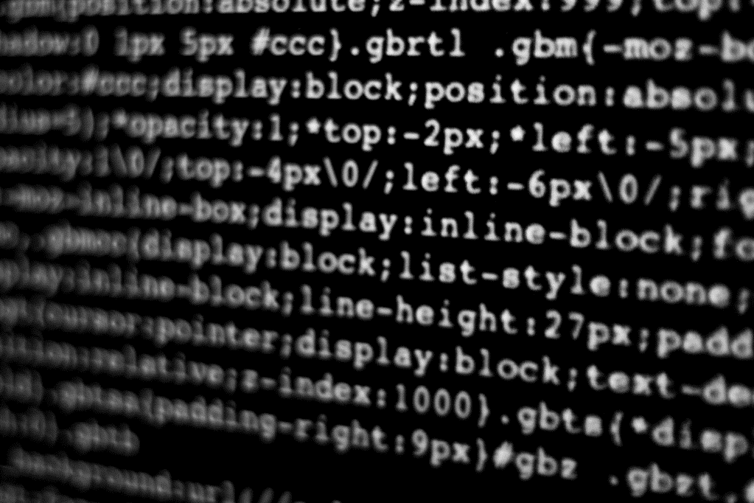
1. s.subashkumar, 2. b.manojKUMAR, 3. s.franglin jabes, 4. r.yokeshwaran,
DONE BY

Slide 3
TITTLE : TO DO PLANNER
In computer programming, "back end" typically refers to the part of a software system or application that is responsible for processing data and performing tasks that are not directly visible to the user. This includes tasks such as database management, server-side scripting, and other server-side logic that is necessary to deliver the front-end user experience.
The back end is often contrasted with the "front end," which refers to the part of a software system or application that the user interacts with directly, such as a website's graphical user interface (GUI) or mobile application. In general, the front end is concerned with presentation and user interaction, while the back end is concerned with processing, storage, and management of data.

Slide 4

THANK YOU
GIT HUB LINK
https://github.com/Attitude15/task-4.git

